Slide 1
Autonomous Vehicle class Final Project
윤 시 원
전자전기공학부 석사 과정
2023000853

Slide 2
Project Goals
Create a map using vrep
SLAM(Simultaneous localization and mapping) to scan the map and plot grid map
Find the optimal path on the grid map using the path planning algorithm

Slide 3
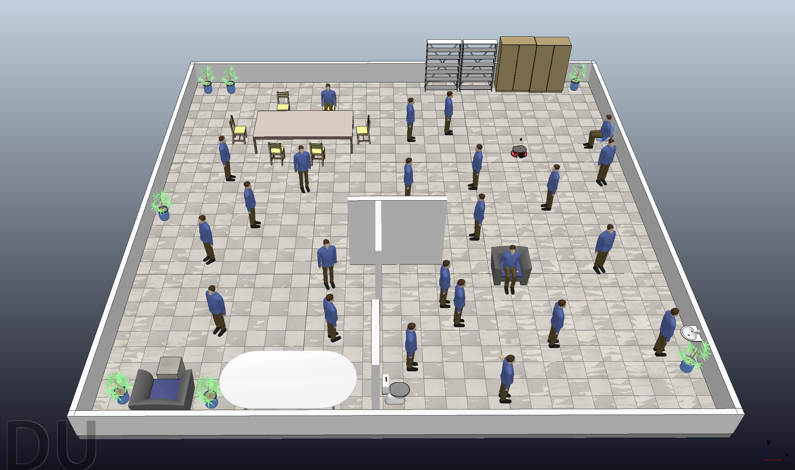
Map
Create a map similar to the indoor environment with many obstacles

Slide 4
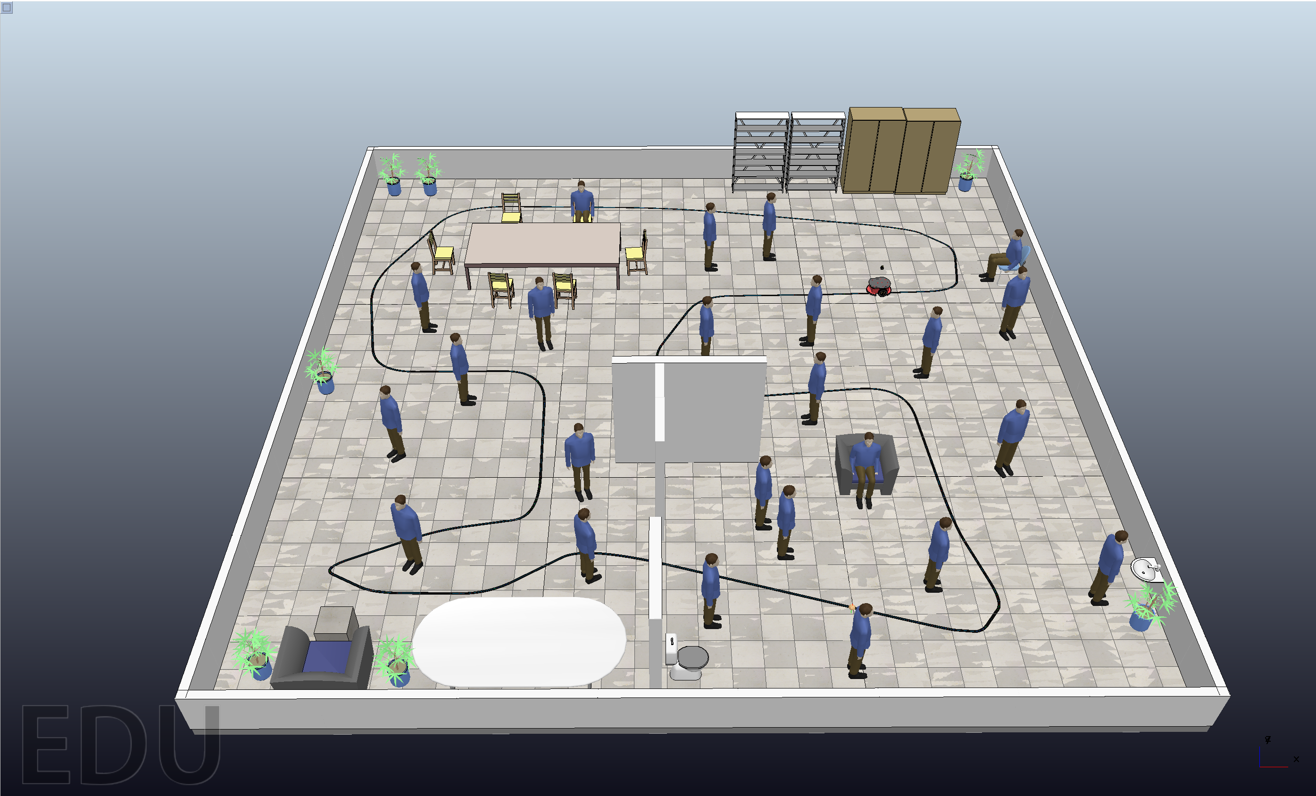
Create Path
Make the robot move along the path and scan the map.

Slide 5
Create Path
Create the path to make the robot can scan all parts of the map.

Slide 6
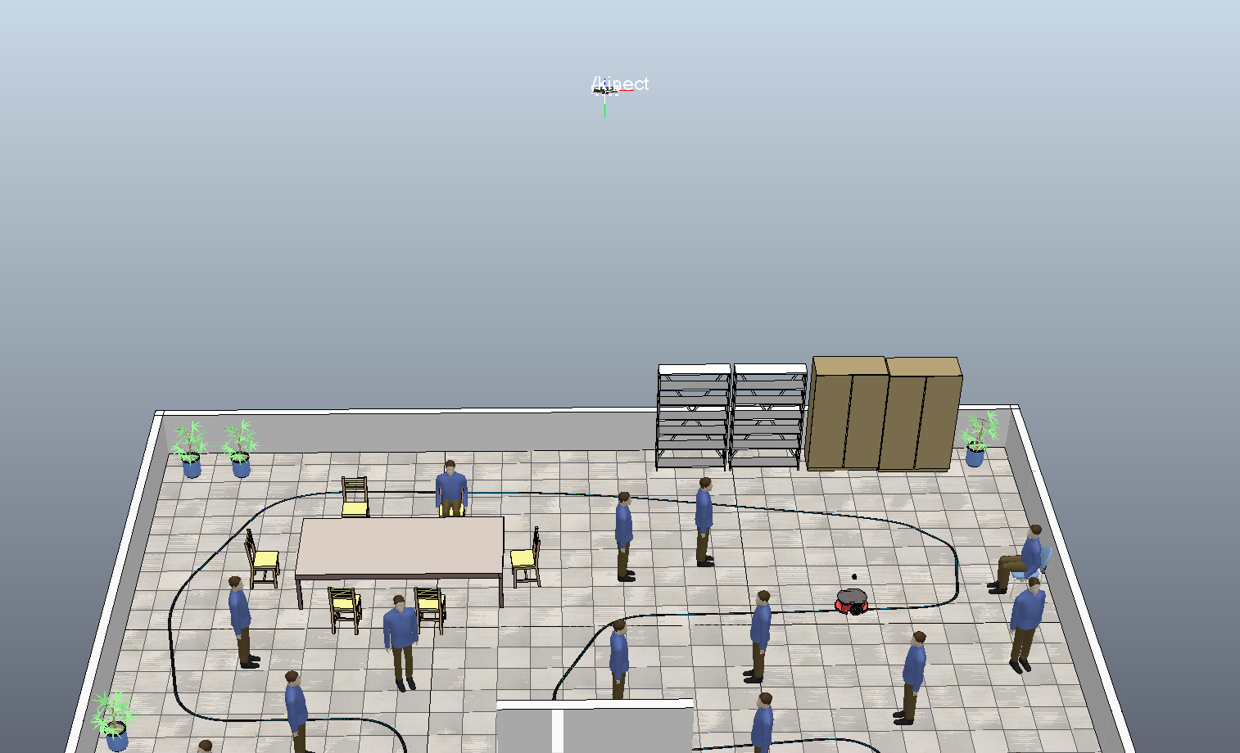
Map
To compare the results with the map scanned with the lidar,
add a top view kinect cam with appropriate FOV and sensing distance

Slide 7
SLAM (Simultaneous localization and mapping)
SLAM : Simultaneous localization and mapping
Reason to do SLAM
: To get a map when the map is unknown
How to do SLAM in vrep and Matlab
Attach sensors to mobile robots that can recognize their surroundings and objects (obstacles), such as LiDAR
Make a path so that the mobile robot can check every part of the map with a sensor (LiDAR)
Send the result data sensed by the lidar to the Matlab
Create a 2d grid map in Matlab based on the transmitted data

Slide 8
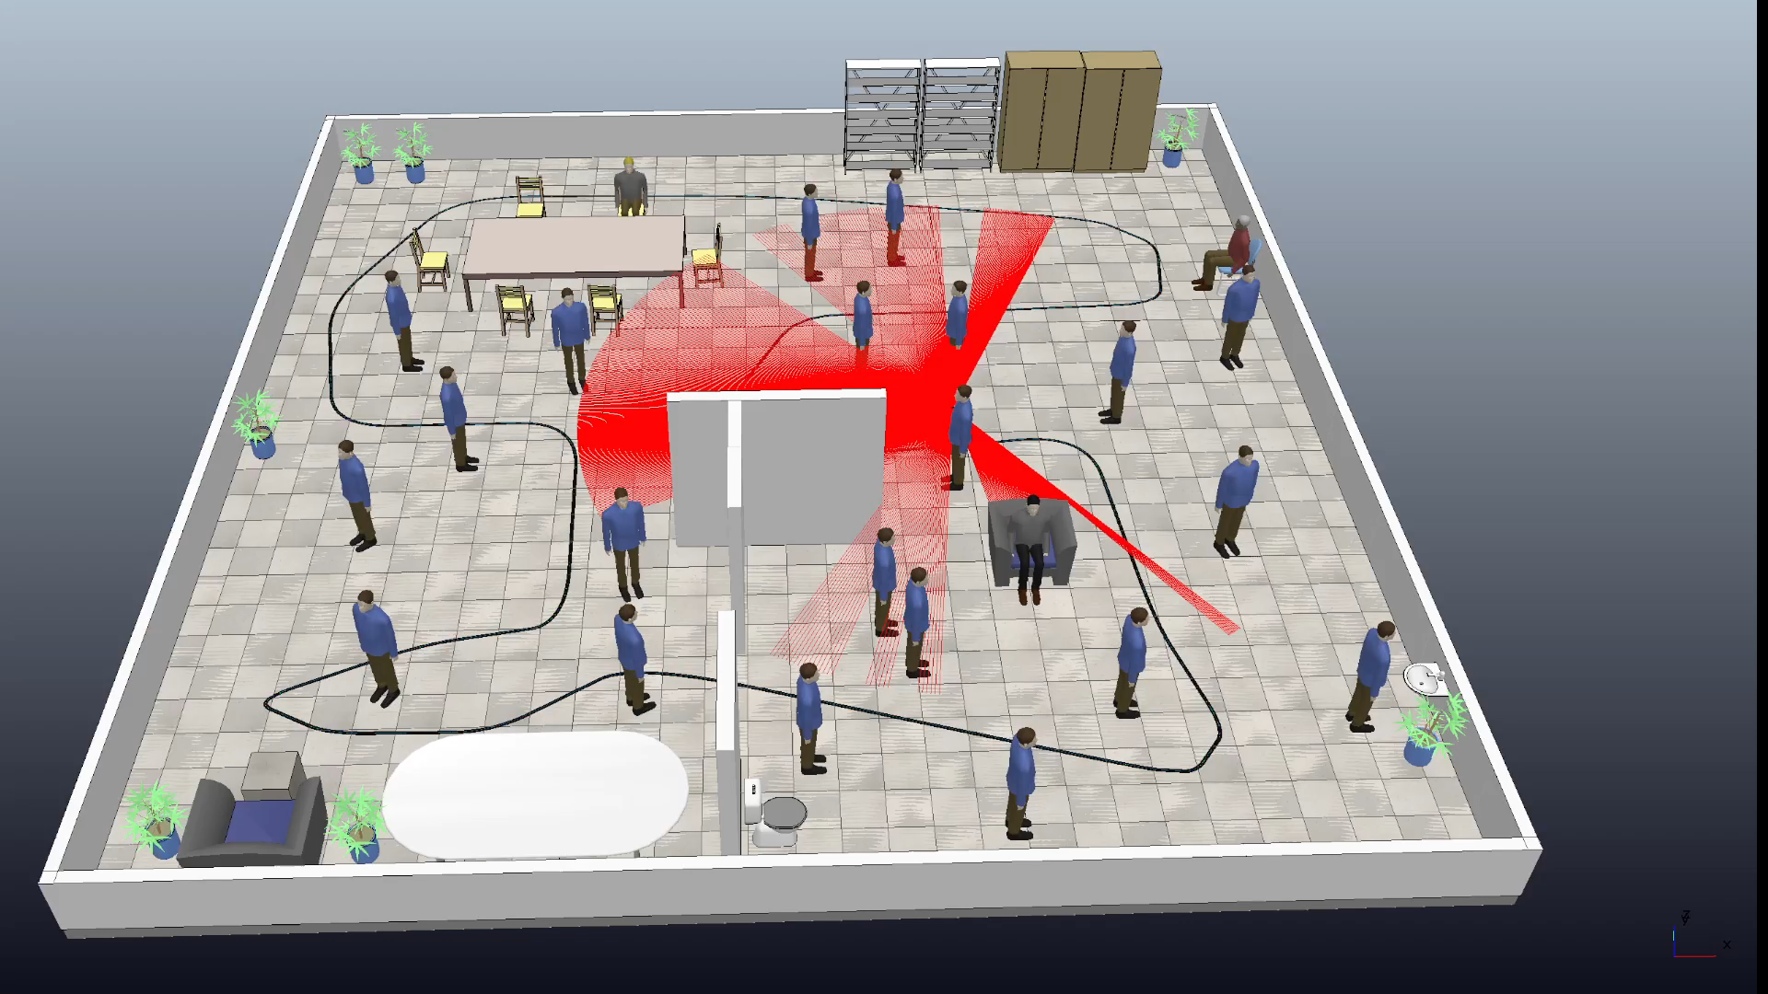
Result (SLAM)
Succeeded to move the robot alog the path
Failed to get LiDAR data.

Slide 9
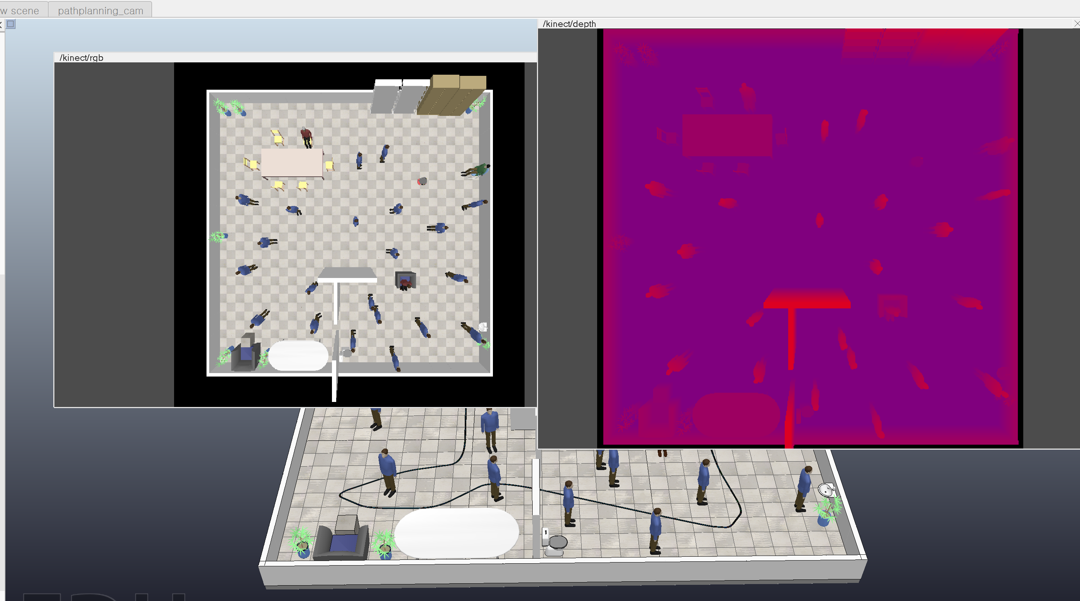
Result (Kinect camera)

Slide 10
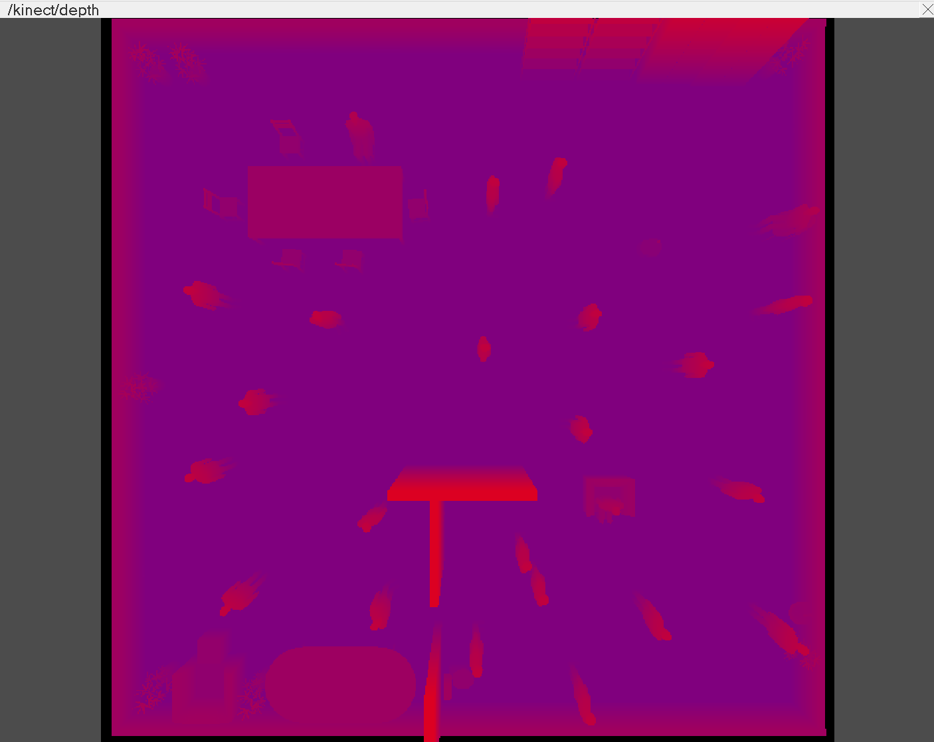
Result (Kinect camera depth)
Importing depth information into the kinect cam succeeded.

Slide 11
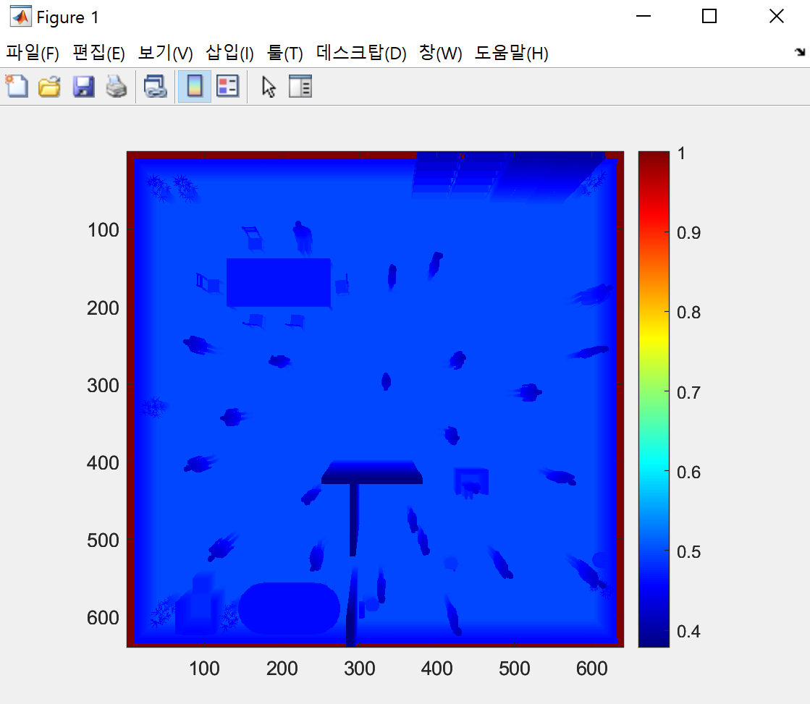
Result (Kinect camera depth)
Can receive data from vrep to Matlab as above.

Slide 12
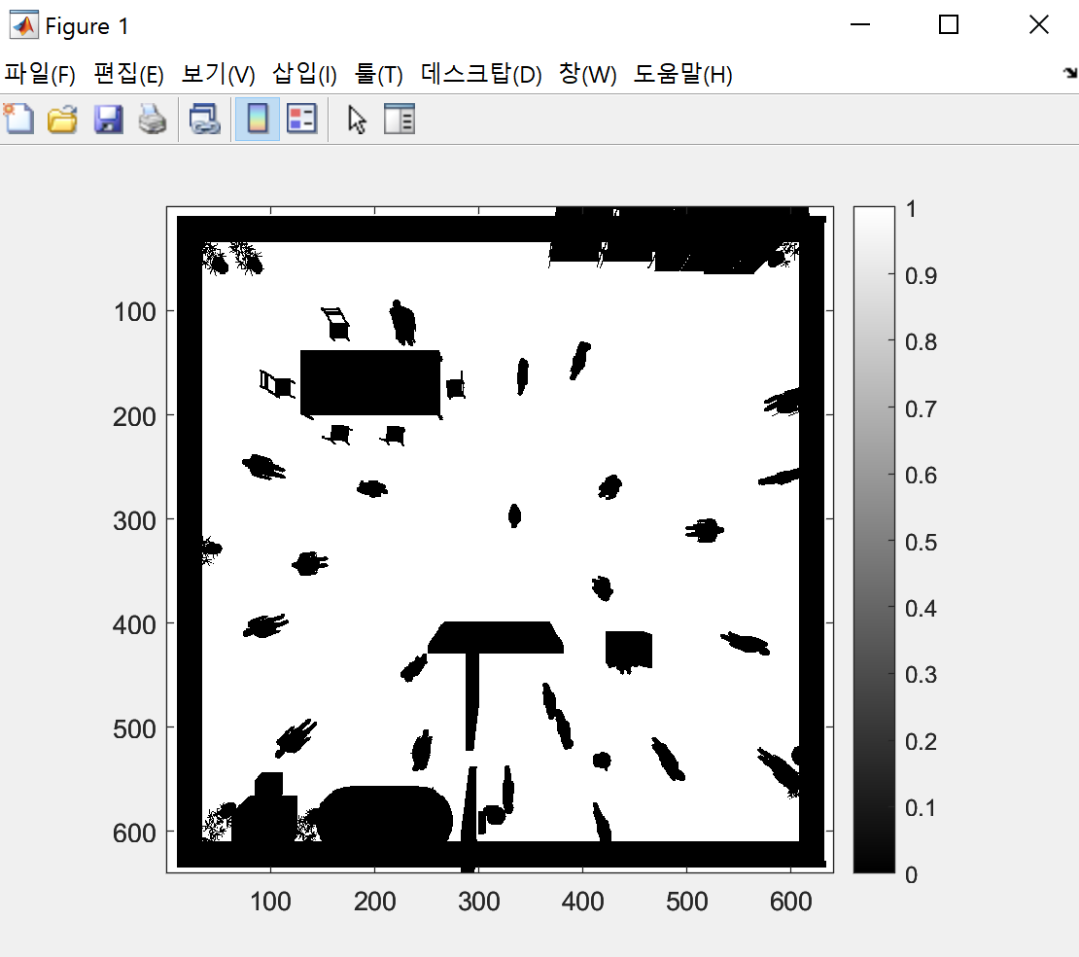
Result (Depth to Matlab gridmap)
Made a binary grid map with 0 and 1 (range change, use threshold)

Slide 13
RRT*
I tried to use path planning algorithm, RRT*
RRT : Rapidly-exploring random trees
Common option that both creates a graph and finds a path. The path will not necessarily be optimal.
One of the sampling-based route planning methods.
Find a path by exploring point-wise spaces by randomly creating multiple sample points without dividing feature spaces into grids

Slide 14
RRT*
RRT* (advanced version of RRT)
Optimized and modified algorithm that aims to achieve a shortest path, whether by distance or other metrics.
RRT + near neighbor search + rewiring tree operations
Near neighbor operations
→ Finds the best parent node for the new node before its insertion in tree
Rewiring operation
→ Rebuilds the tree within

Slide 15
Failure Analysis
Tried RRT* with matlab, but it doesn't work.
Use PlannerRRTStar → Failed to pass validation
Tried to change the start point and the goal point.
Simplified the map
Changed map to mat file
If RRT* worked
Find the best route through matlab.
Check if the route could be implemented in vrep.
Try to simulate in vrep.

